Slide 1
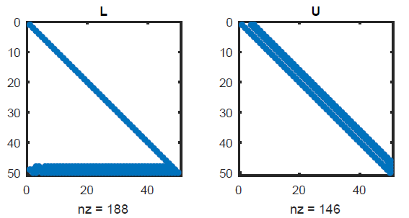
Chapter 8 Krylov Methods in Linear Algebra

Slide 2
Section 8.1 Sparsity and Structure

Slide 3
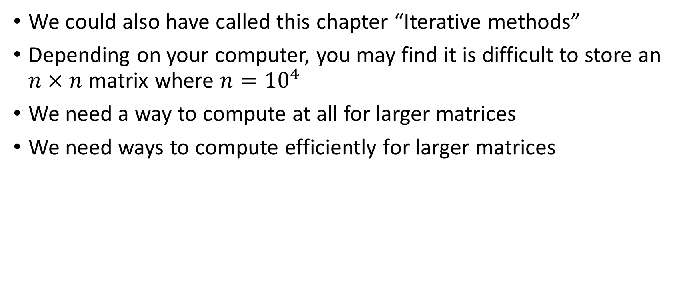
Methods for large matrices/systems
We could also have called this chapter “Iterative methods”
Depending on your computer, you may find it is difficult to store an $n×n$ matrix where $n={10}^{4}$
We need a way to compute at all for larger matrices
We need ways to compute efficiently for larger matrices

Slide 4
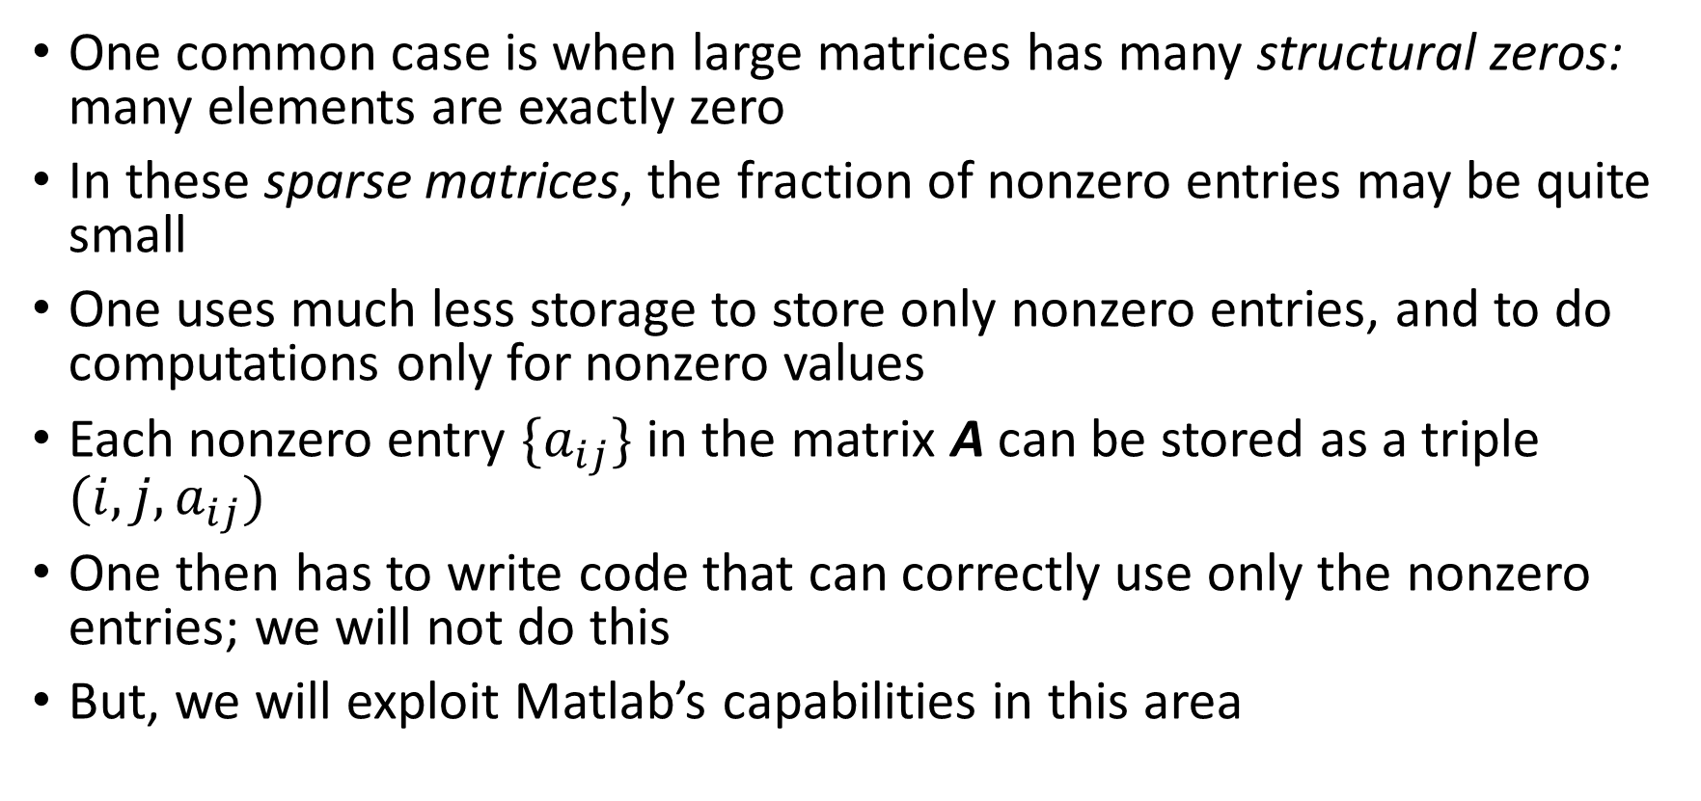
Sparse matrices
One common case is when large matrices has many structural zeros: many elements are exactly zero
In these sparse matrices, the fraction of nonzero entries may be quite small
One uses much less storage to store only nonzero entries, and to do computations only for nonzero values
Each nonzero entry $\{a_{ij}\}$ in the matrix A can be stored as a triple $(i,j,a_{ij})$
One then has to write code that can correctly use only the nonzero entries; we will not do this
But, we will exploit Matlab’s capabilities in this area

Slide 5

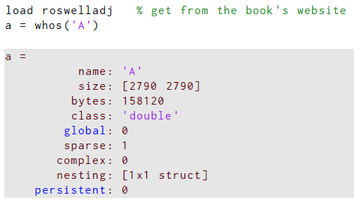
Example: large adjacency matrix
A is an adjacency matrix for web pages making about Roswell, NM, and how they link to each other.
It’s large
The elements are double precision
It’s sparse!
Real valued

Slide 6
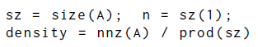
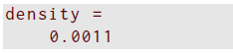
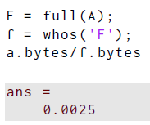
Example: large adjacency matrix
Each nonzero entry in A corresponds to an edge; we can compute fraction of nonzeros: call that the density
size returns the number of rows and columns
nnz returns the number of nonzero elements
Sparse!
full creates the full matrix storage version
Compare storage of sparse vs full matrix versions
How about computation time?

Slide 7
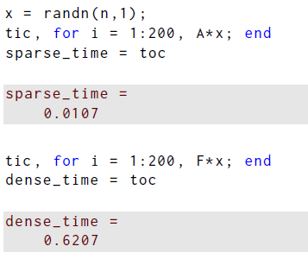
Example: large adjacency matrix
Computation time for sparse vs full? Sparse uses only nonzeros
tic and toc for timing
Matrix vector products first
Create random vector, repeat 200x for timing
Sparse first, then full
60x slower for full!

Slide 8
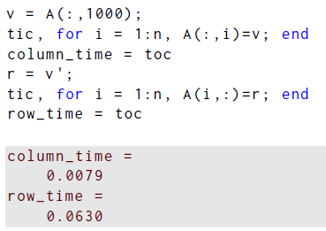
Example: large adjacency matrix
Computation time for row operations can be slower: Matlab’s sparse storage is column oriented
Column oriented
Row oriented
8x slower for rows

Slide 9

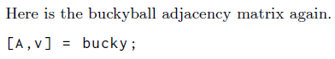
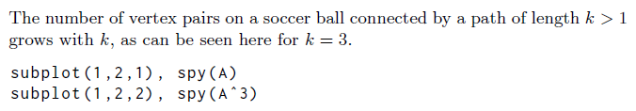
Matrix fill-in
Arithmetic operations *,+,-,^ can exploit sparsity
But, matrix operations can reduce the sparsity: matrix fill-in
The spy command plots nonzero elements and gives the number of nonzeros…

Slide 10
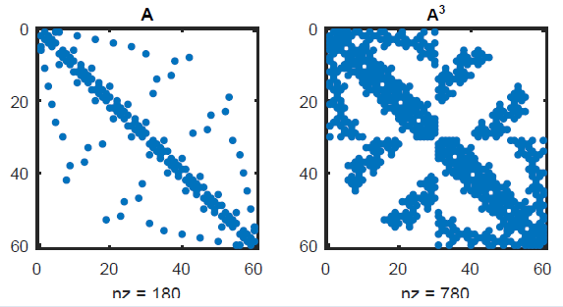
Matrix fill-in
The number of nonzeros increased by more than 4x

Slide 11
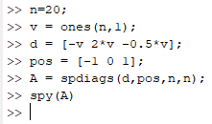
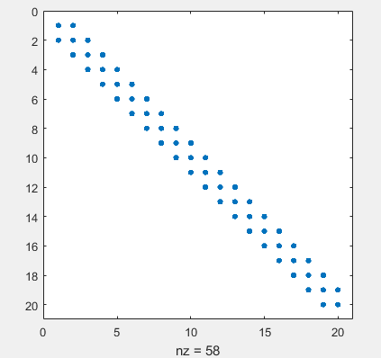
Banded matrices
This is an important class of matrices that comes up in applications
The simplest is the diagonal matrix: bandwidth 1
Another is tridiagonal, with main diagonal, as well as one superdiagonal and one subdiagonal: bandwidth is 3
More generally, if p nonzero superdiagonals, and q nozero subdiagonals, then bandwidth is p+q-1

Slide 12

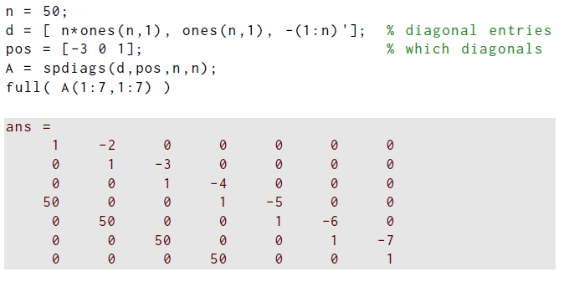
Example: solving a banded system
Sparse tridiagonal matrix created
Matlab trims the size of the vectors put into the diagonals
Full version displayed
Solving a system?

Slide 13
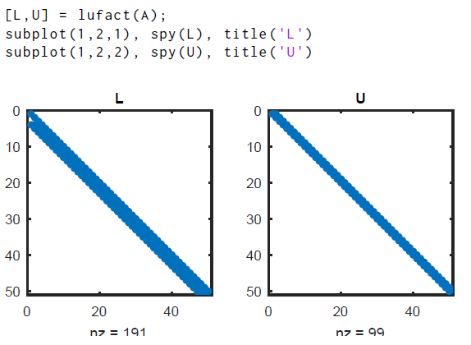
Example: solving a banded system
No pivoting here
Small bandwidth preserved

Slide 14
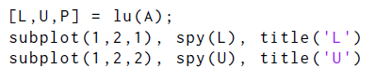
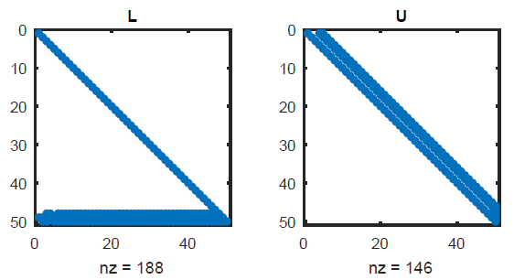
Example: solving a banded system
Pivoting used here
Bandwidth grows a little in U, but a lot in L to roughly n/2

Slide 15
Linear systems and eigenvalues
Say one starts with a sparse matrix A and compatible right-hand-side b
In Matlab, A\b will automatically try a sparse-aware form of Cholesky or pivoted LU factorization
This approach could beat the O(n^3) cost for the general case with a full matrix, but this depends on the sparsity pattern of A
For a very large A, it is unlikely that one would compute all of the eigenvalues and eigenvectors of A, that is, one would typically not use eig for very large matrices
For very large A, one would use eigs (Sec 8.4) to find the a selected number of eigenvalues, often the largest or those nearest a selected complex number (the s at the end indicates sparse; there is a similar svds command)

Slide 16

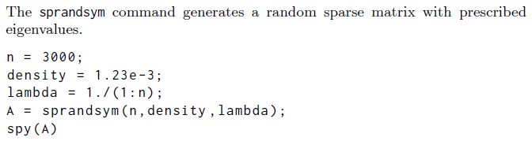
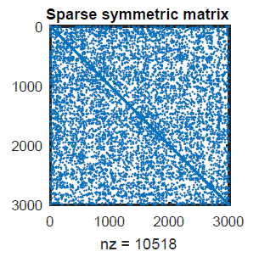
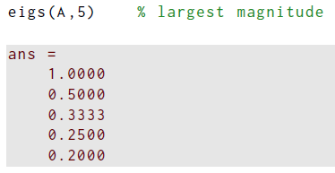
Example: sparse matrix eigenvalues

Slide 17
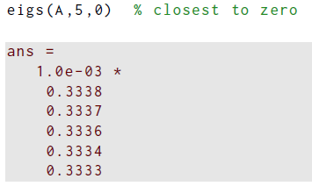
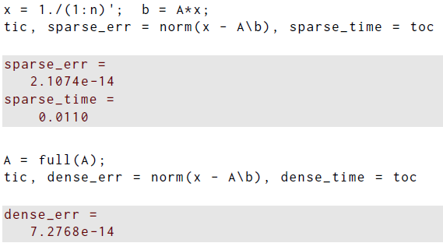
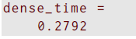
Example: sparse matrix eigenvalues
Predicting order of FlOps is difficult without info re A
But sparse calculation is often faster

Slide 18
Section 8.2 Power Iteration

Slide 19

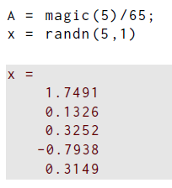
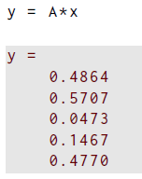
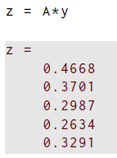
Example: repeated matrix multiplication
Let’s use that fast matrix-vector multiplication
Nothing to good happening yet
Now try more factors of A

Slide 20
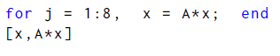
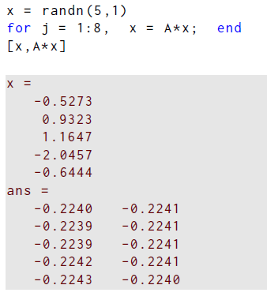
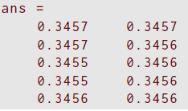
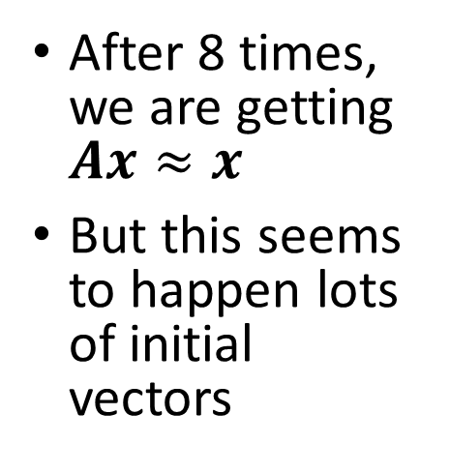
Example: repeated matrix multiplication
After 8 times, we are getting $Ax≈x$
But this seems to happen lots of initial vectors

Slide 21
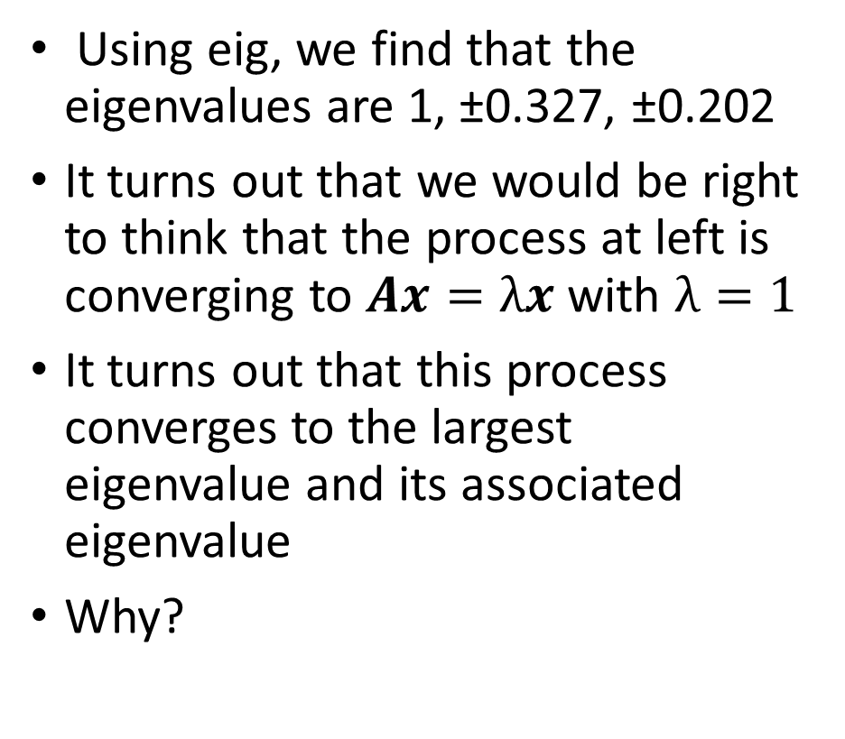
Example: repeated matrix multiplication
Using eig, we find that the eigenvalues are 1, ±0.327, ±0.202
It turns out that we would be right to think that the process at left is converging to $Ax=λx$ with $λ=1$
It turns out that this process converges to the largest eigenvalue and its associated eigenvalue
Why?

Slide 22
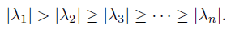
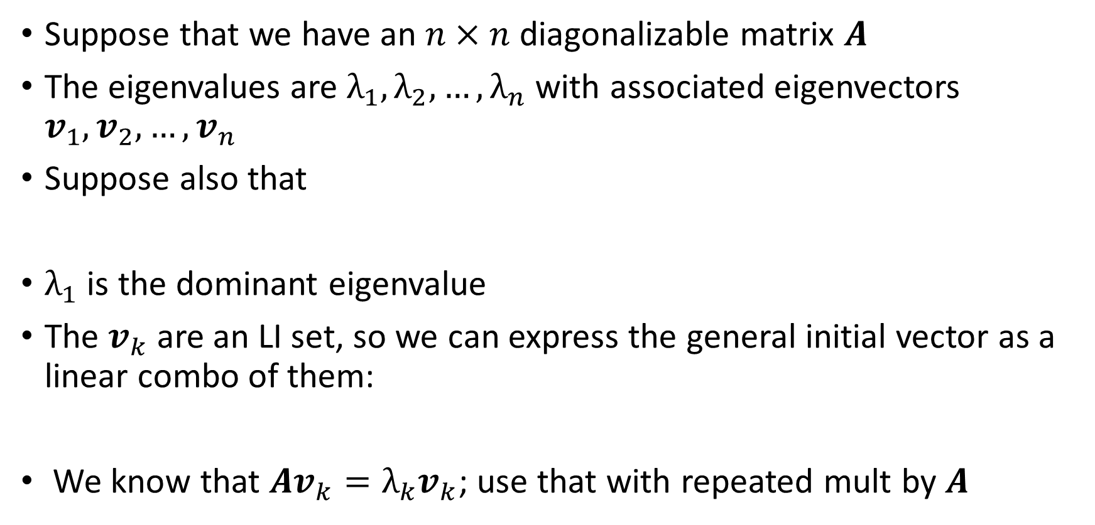
Dominant eigenvalue
Suppose that we have an $n×n$ diagonalizable matrix $A$
The eigenvalues are $λ_{1},λ_{2},…,λ_{n}$ with associated eigenvectors $v_{1},v_{2},…,v_{n}$
Suppose also that
$λ_{1}$ is the dominant eigenvalue
The $v_{k}$ are an LI set, so we can express the general initial vector as a linear combo of them:
We know that $Av_{k}=λ_{k}v_{k}$; use that with repeated mult by $A$

Slide 23
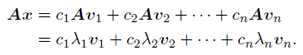
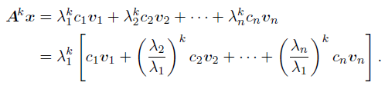
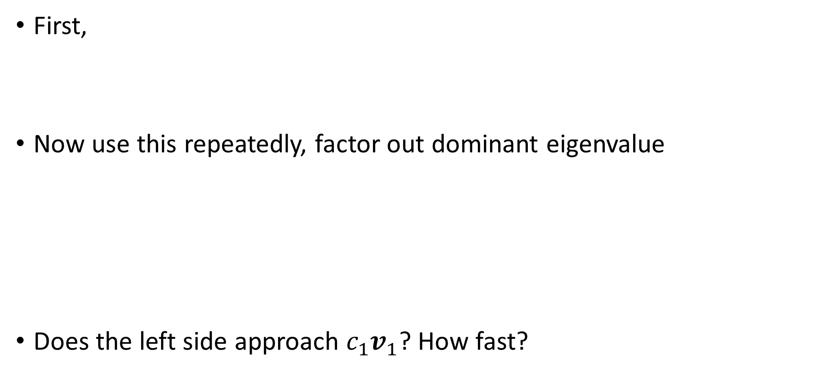
Dominant eigenvalue
First,
Now use this repeatedly, factor out dominant eigenvalue
Does the left side approach $c_{1}v_{1}$? How fast?

Slide 24
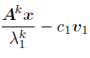
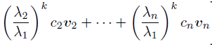
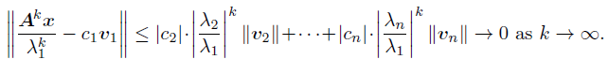
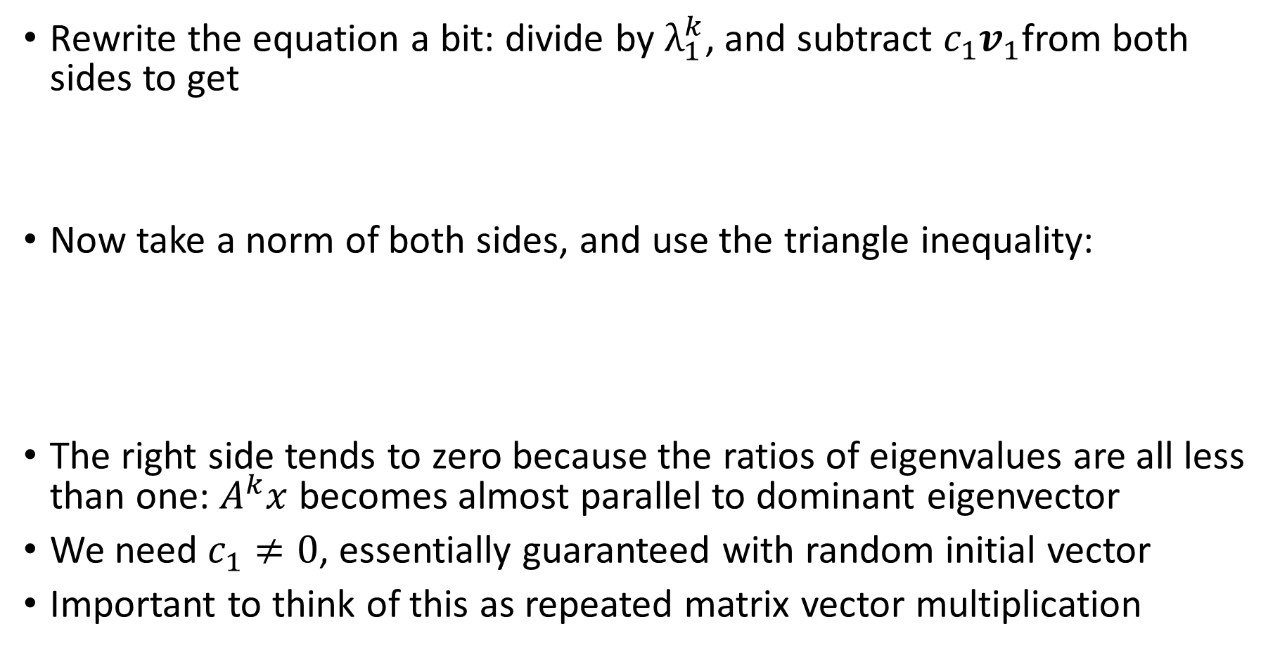
Dominant eigenvalue
Rewrite the equation a bit: divide by $λ_{1}^{k}$, and subtract $c_{1}v_{1}$from both sides to get
Now take a norm of both sides, and use the triangle inequality:
The right side tends to zero because the ratios of eigenvalues are all less than one: $A^{k}x$ becomes almost parallel to dominant eigenvector
We need $c_{1}≠0$, essentially guaranteed with random initial vector
Important to think of this as repeated matrix vector multiplication

Slide 25
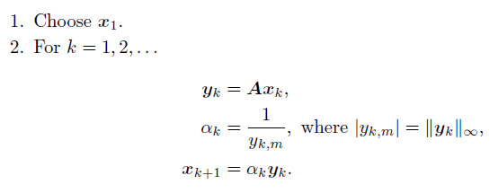
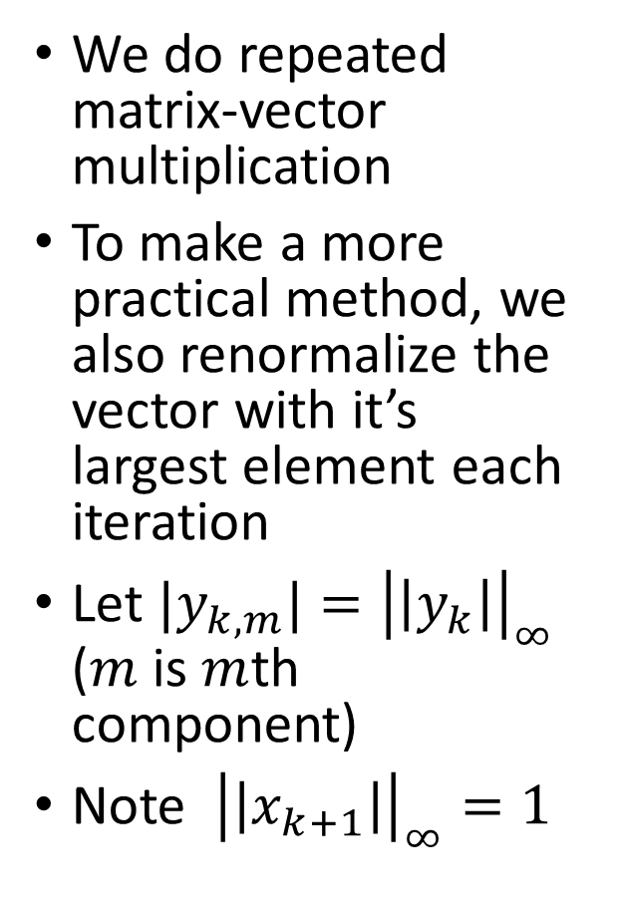
Power iteration
We do repeated matrix-vector multiplication
To make a more practical method, we also renormalize the vector with it’s largest element each iteration
Let $|y_{k,m}|={\left|\left|y_{k}\right|\right|}_{∞}$ ($m$ is $m$th component)
Note ${\left|\left|x_{k+1}\right|\right|}_{∞}=1$
Power iteration algorithm:

Slide 26
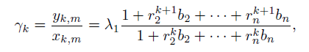
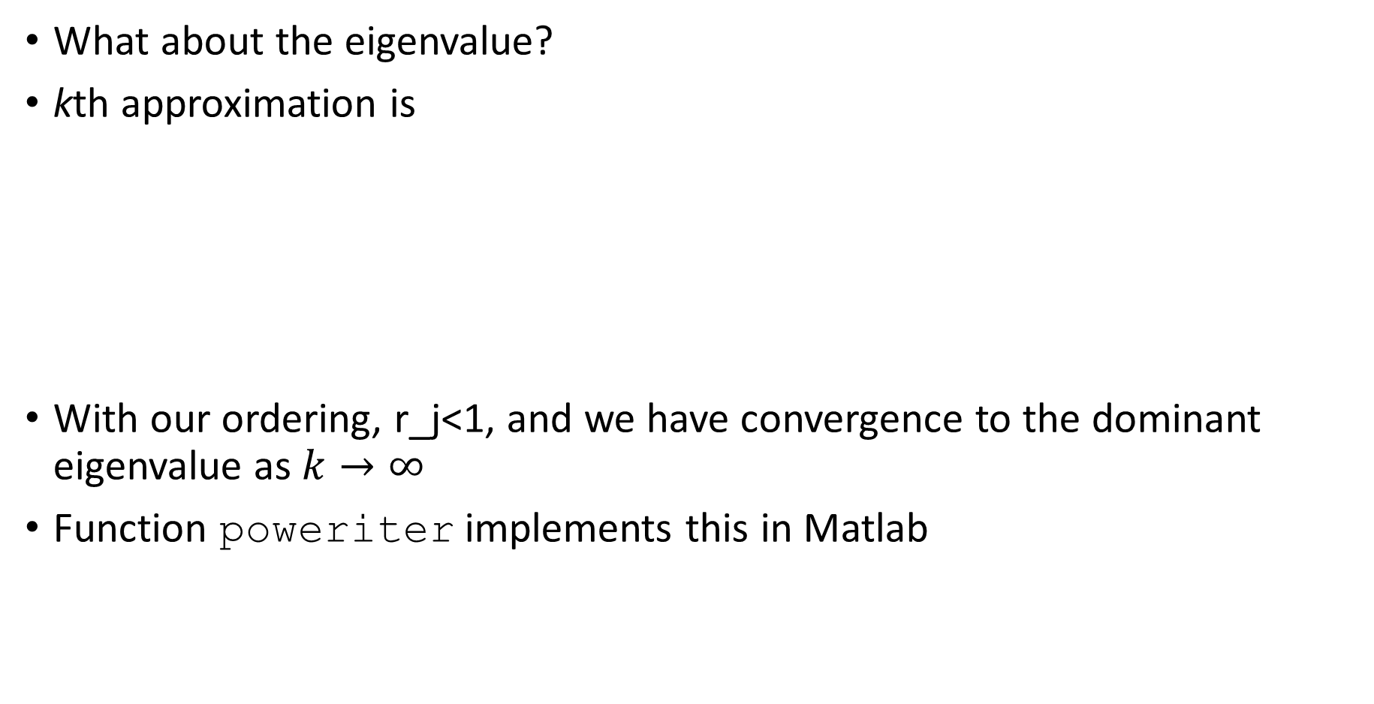
Dominant eigenvalue
What about the eigenvalue?
kth approximation is
With our ordering, r_j<1, and we have convergence to the dominant eigenvalue as $k→∞$
Function poweriter implements this in Matlab

Slide 27
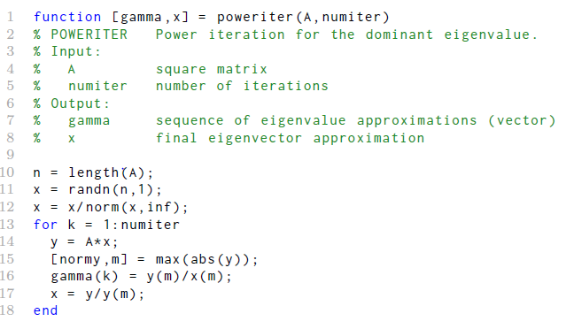
Function poweriter
max returns max value and location in vector
Sparsity used automatically

Slide 28
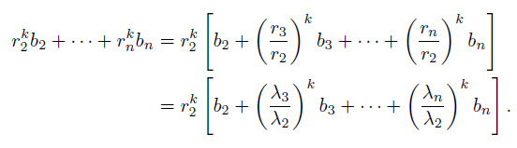
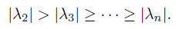
Convergence of power iteration
Return to kth approximation:
Consider the denominator:
For simplicity, assume that

Slide 29
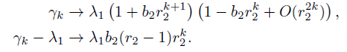
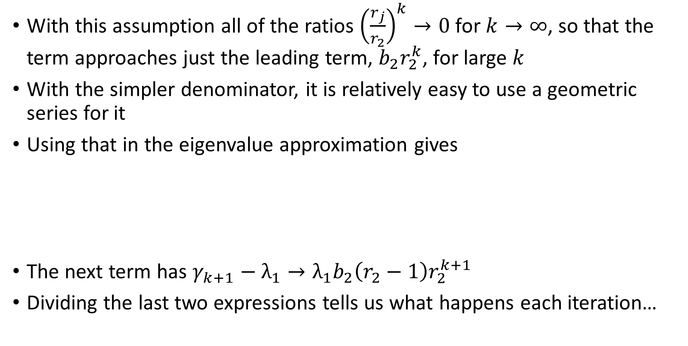
Convergence of power iteration
With this assumption all of the ratios ${\left(\frac{r_{j}}{r_{2}}\right)}^{k}→0$for $k→∞$, so that the term approaches just the leading term, $b_{2}r_{2}^{k}$, for large $k$
With the simpler denominator, it is relatively easy to use a geometric series for it
Using that in the eigenvalue approximation gives
The next term has $γ_{k+1}−λ_{1}→λ_{1}b_{2}\left(r_{2}−1\right)r_{2}^{k+1}$
Dividing the last two expressions tells us what happens each iteration…

Slide 30


Convergence of power iteration
We find that the ratio is
The new approximation is roughly a factor of r_2 closer than the old one
This is linear convergence: the error drops by a constant factor each time
It is usually true once one has a done a few iterations, so that the computed values start to come from “large $k$”
Thinking of taking this limit for a (potentially) large number of iterations is what we mean when we say:

Slide 31



Example: convergence
How fast do iterates gamma converge to eigenvalues?
Blue: $λ_{2}=6$; red: $λ_{1}=12$
Linear convergence to $λ_{1}$

Slide 32
Convergence of power iteration
This is not a practical implementation
We will continue to improved methods

Slide 33
Section 8.3 Inverse Iteration

Slide 34
Inverse iteration
Power iteration only finds the dominant eigenvalue
We can extend power iteration to find other eigenvalues
The idea is to use some simple linear algebra results to change the relative sizes of the eigenvalues

Slide 35

Inverse iteration
Here are those linear algebra results

Slide 36

Inverse iteration
Great options for moving around eigenvalues, if true
Consider item 1: start with $Av=λv$; subtract $sIv$ from both sides
$$Av−sIv=λv−sIv →$$
$$\left(A−sI\right)v=\left(λ−s\right)v$$
We have that a matrix times a vector gives a scalar times the same vector, as in part 1: proven.
For part 2, we assumed that $s≠λ_{k}$, so $A−sI$ is non-singular, then straightforward rearrangement gives
$${\left(A−sI\right)}^{−1}v={\left(λ_{k}−s\right)}^{−1}v$$
This proves that item 2 is true.
Item 3 follows too.

Slide 37




Inverse iteration
Consider item 2 with $s=0$: start with $A$ having a smallest eigenvalue:
Then
so that the reciprocal of the smallest eigenvalue is now the dominant one
We can use power iteration to find the reciprocal value, and thus approximate the smallest eigenvalue (the one closest to zero)
This is inverse iteration
The convergence rate is linear again, with rate

Slide 38


Shifted inverse iteration
Consider $s≠0$: order eigenvalues of $A−sI$ with distance from
Then
We can use power iteration to find the first reciprocal value, and thus approximate the eigenvalue closest to $s$
This is shifted inverse iteration
Power iteration on ${\left(A−sI\right)}^{−1}$ converges to ${\left(λ_{1}−s\right)}^{−1}$ provided that $λ_{1}$ is closest to $s$

Slide 39



Shifted inverse iteration
There is a new computational wrinkle here
We want to find: for a sequence of $k$ values
However, we do NOT want to compute ${\left(A−sI\right)}^{−1}$ to do it!
Instead, we could write what is needed as
The solve is the computational version of the inverse, but is faster

Slide 40

Shifted inverse iteration
We need
To begin with, we use PLU factorization, and live with any fill-in that may result for sparse matrices
Function 8.3.1 does inverse iteration
Note that the iteration is for $β_{k}={\left(γ_{k}−s\right)}^{−1}$; the approximation to the original eigenvalue is $γ_{k}=s+β_{k}^{−1}$

Slide 41

Function inviter
Random x ensures some component in eigenvector direction
Should be s*speye(n) here

Slide 42




Example: inverse iteration
Create a $5×5$ matrix with known eigenvalues
Use $s=0.7$ and do 30 iterations
Convergence is to closest eigenvalue with value 0.6

Slide 43



Example: inverse iteration
We could also compute the ratio $\left(γ_{k+1}−s\right)/\left(γ_{k}−s\right)$ in Matlab using s=0.7 and
seq_of rate = (gamma(2:end)-s)./(gamma(1:end-1)-2)
and see that the sequence of ratios approaches 1/3

Slide 44

Example: inverse iteration
Convergence rate is linear: drops by constant factor of about 0.33 each time
How do we know this?

Slide 45

Dynamic shifting
In our last example, we left $s$ as a single value throughout the iteration
This works reasonably well, but one can do better
This time, let $s=γ_{k}$ when we compute $γ_{k+1}$
So, we are adjusting s on the fly
How well does it work?

Slide 46




Example: inverse iteration
Same $5×5$ matrix as previous example
Use $s=0.7$ and do 1 iteration
Change $s$ to $γ$ and repeat
Doesn’t look too good yet, but…

Slide 47

Example: inverse iteration
Now repeat the process a few times
Boom!
Convergence is very rapid: roughly double the number of digits each time
This is quadratic convergence
Like Newton’s method near a root

Slide 48

Dynamic shifting
There is a price for this increased rate of convergence
Before, with constant shift, we could factor $A−sI$ once, and each iterate is faster, but there can be many more
With dynamic shifting, we need to factor $A−s_{k}I$ for each iteration but there may be many fewer iterations
For our examples, 30 iterates for constant shift, only 6 with dynamic shift
In many cases it pays off to dynamically shift.

Slide 49
Section 8.4 Krylov Subspaces

Slide 50


Krylov subspaces
Say we start with a seed vector $u$
If we repeatedly multiply by a matrix $A$, we can keep all of the products, and try to use that set as a basis for approximating answers.
Thus, we are creating the set $u, Au, A^{2}u, …$
In the power or inverse iterations we only kept the latest on each time
We get the $n×m$ Krylov matrix if the columns are $u, Au, A^{2}u, …$

Slide 51

Krylov subspaces
The columns of the $n×m$ Krylov matrix are important
The columns form the $m$th Krylov subspace $𝓚_{m}$ of $ℂ^{n}$
Each column is $n$ long, but there are only $m$ columns
We want to approximate answers from this subspace; said another way, we want to find answers that are a linear combo of the columns
The dimension of $𝓚_{m}$ is the same as the rank of $K_{m}$, which is often $m$ but may be smaller

Slide 52


Properties
Generating columns of Krylov matrix is relatively easy for sparse $A$
And, there are some nice properties…

Slide 53


Properties
Part 1 simply says that if ${x∈𝓚}_{m}$, then for some coefficients $c_{1}, c_{2}, …, c_{m}$, $x$ can be written as
Then, let ${z=[c}_{1} c_{2}…{ c}_{m}]T$, and recall that
For Part 3, just multiply the first equation by A, and one has

Slide 54

Reducing dimension and solving linear systems
Consider the linear system $Ax=b$ for $n×n$ nonsingular $A$
The original idea for using Krylov subspaces was to create a space with $n$ basis vectors, $𝓚_{n}$
This could come with a predetermined number of steps, making it a direct method ($m=n$ here for multiplications by $A$)
However, the columns of $K_{m}$ effectively come from power method
The columns are converging to the dominant eigenvector
This makes the direct method with $m=n$ ill-conditioned and impractical

Slide 55


Reducing dimension and solving linear systems
An alternative view is to say that most of the approximation or information is in the first few columns; the farther out columns are nearly dependent
Why not stop early and perhaps get a good approximation with only $m<n$ basis vectors, that is, $𝓚_{m}$
The problem changes then to one where we don’t know in advance when to stop: it becomes an iterative method.
Also, we need to get the best answer for the system $Ax=b$ with $n$ unknowns: this suggests a minimization of the error:

Slide 56

Reducing dimension and solving linear systems
For the linear system $Ax=b$, the natural choice to start the Krylov iteration is $u=b$
We do adjust the size of each column with a normalization to prevent wildly different sizes of the elements
Let’s do an example

Slide 57


Example: Krylov iteration
$m$th column of $K_{m}$ created each time
Normalize the column and append it

Slide 58


Example: Krylov iteration
Use the first $m$ columns of $K_{m}$ to approximate the solution
\ does least squares solution here
Compute and save the residual

Slide 59


Example: Krylov iteration
Residual “stalls” at m=17
Matlab throws warnings at that point because $K_{m}$ is nearly singular
We need a better approach!

Slide 60


Fixing the problem
The Krylov matrix we were generating was for $m=30$ with
After column 17, any new columns were nearly dependent on the previous ones: warnings for $m≥17$
The opposite of this problem is to use an orthogonal matrix, where the columns are far from dependent
Try QR factorization:

Slide 61

Fixing the problem
The columns $q_{j}, j=1,…,m$of $Q$ are orthonormal
And, they are a basis for $𝓚_{m}$!
From Lemma 8.4.1, we know that multiplying a vector in $𝓚_{m}$with $A$ will produce a vector in $𝓚_{m+1}$
Using the last column of $Q$, we know that
$$Aq_{m}∈𝓚_{m+1}$$
It’s then a linear combo of the $m+1$ columns of another $Q$:

Slide 62


Fixing the problem
Because the columns $q_{j}$ are orthonormal,
$$q_{i}^{∗}q_{j}=0, i≠j$$
$$q_{i}^{∗}q_{j}=1, i=j$$
Premultiply by $q_{i}^{∗}$, and only one term on the right survives:
( )
We get $q_{i}^{∗}\left(Aq_{j}\right)=H_{im}, i=1,…,m$
Orthonormality of the $q_{j}$ makes this easy!!
The first $m$ $q_{j}$ are known, and the $H_{im}$are then determined.
What about the last term on the right?

Slide 63

Fixing the problem: Arnoldi iteration
With the first $m$ $q_{j}$ are known, and the $H_{im}$ found, we can rearrange:
$$H_{m+1,m}q_{m+1}=Aq_{m}−\sum_{i=1}^{m}{H_{im}q_{i}}$$
Now, we only know $H_{m+1,m}q_{m+1}$
However, we know that we want $q_{m+1}$ to be a unit vector
So, we can make $H_{m+1,m}$ the norm of the result, and make $q_{m+1}$ its direction.
This is called Arnoldi iteration

Slide 64


Arnoldi iteration
Here’s an algorithm
The big improvement here is that the Arnoldi algorithm finds an orthonormal basis for the Krylov subspace

Slide 65



Example: Arnoldi iteration
Make a few steps of Arnoldi iteration for a small matrix
The first column was the unit vector in the u direction
The second vector is A times that first vector, then normalized

Slide 66



Example: Arnoldi iteration
Make a few steps of Arnoldi iteration for a small matrix

Slide 67


A Key Identity
We focused on the $q_{j}$ so far, but the $H_{im}$ are important too
They can be assembled into an upper Hessenberg matrix:
This is a fundamental identity for Krylov subspace methods
We will study practical and widely used methods based on it

Slide 68


Slide 69
Section 8.5 GMRES

Slide 70


GMRES: Using Arnoldi iteration
Arnoldi iteration may be most widely used to solve the square linear system $Ax=b$ for $n$ unknowns $x$
The Krylov basis (columns of $K_{m}$) was bad because some of the basis vectors were nearly dependent
We tried to solve
But, we found trouble when $m$ got bigger
We then went to an orthonormal basis from the QR factorization
$${K_{m}=Q}_{m}R_{m}$$

Slide 71



GMRES: Using Arnoldi iteration
Use the orthonormal columns of as the basis for the approximate answer: $x=Q_{m}z$ for $n$ unknowns $x$
Then we have converted the problem to
At this point, there are $n$ equations for the $m$ coefficients in $z$
To make the method efficient, we can make the system smaller: use ${AQ}_{m}=Q_{m+1}H_{m}$
Then we have

Slide 72


GMRES: Using Arnoldi iteration
This system still has $n$ equations for the $m$ coefficients in $z$
Note that $b$ is a multiple of the unit vector $q_{1};$ we can then write
$$b=\left|\left|b\right|\right|Q_{m+1}e_{1}$$
Now substitute for $b$, to get the new problem
Is this better? It is still $n$ equations for the $m$ coefficients in $z$
But, for ${w∈ℂ}^{m+1}$, we have

Slide 73


GMRES: Using Arnoldi iteration
These orthogonal matrices don’t change the norm!
We need only minimize the smaller system without the $Q_{m+1}$
Thus
becomes
Is this better? Now only $(m+1)$ eqns for the $m$ coefficients in $z$
The solution for this system is $z_{m}$
The solution to the original system is approximately ${x_{m}=Q}_{m}z_{m}$

Slide 74

GMRES: Using Arnoldi iteration
This method is called GMRES, for Generalized Minimum RESidual
$${x_{m}=Q}_{m}z_{m}$$
GMRES uses the output of the Arnoldi iteration to minimize the residual of $Ax = b$over successive Krylov subspaces.
Let’s look at an example

Slide 75





Example: GMRES
Matrix with known e-values and random b
$K_{m}$ not used, created Q,H instead
Create a sequence of 60 approximations using one more column each time
Plot all the residuals

Slide 76

Example: GMRES
Error drops to nearly machine epsilon before 50 columns
No stalling of the error here

Slide 77

GMRES
A basic version of the algorithm is implemented in Function 8.5.1

Slide 78

GMRES
A basic version of the algorithm is implemented in Function 8.5.1
Matlab has a more sophisticated version: gmres

Slide 79

GMRES: convergence and restarting
The residual $\left|\left|r_{m}\right|\right|=||b−Ax_{m}||$ can’t increase during Arnoldi iteration because minimization over the largest space includes the previous ones
But, it is difficult to say more than that.
The previous example showed the cleanest behavior.
It turns out that phases of sublinear and superlinear convergence can happen in (typically larger) systems. This depends on the spectrum of the matrix.
Also, the number of columns of $Q$ and the number of entries in $H_{m}$: work and storage grow like $m^{2}$, which can be too much
Using GMRESS with restarting can help

Slide 80
GMRES: convergence and restarting
Good things about restarting:
one does not lose the previous gain of getting close to the answer
one uses low dimensional approximations again so that memory used is never allowed to get too large
However, the low dimensional approximations may retard or even stagnate progress
Matlab’s GMRES function allows restarting
Number of restarts (including initial): outer iterations
Number of iterations after restarting: inner iterations

Slide 81


Example: GMRES with restarting
Matrix discretizing a PDE that will be used not uncommonly
The name compes from the PDE problem: Poisson equation
From built-in gallery function
Gives a large matrix

Slide 82


Example: GMRES with restarting
We use these five input arguments

Slide 83
Example: GMRES with restarting
We use these five input arguments
Matrix A
Specifies tolerance for method (1e-6 default)
MAXIT specifies limit for outer iterations
RHS b
Restart after
RESTART inner
iterations

Slide 84

Example: GMRES with restarting
We use only the last of these five outputs here
X is approximate answer is X
RELRES gives relative residual of X, ||B-A*X||/||B||
FLAG states whether we achieved the tolerance
ITER returns the outer and inner iteration number of the solution
RESVEC is the list of residual values over iterations ||B-A*X||

Slide 85


Example: GMRES with restarting
Most restarts: GMRES had not got to rapidly converging part before restart
No restarts

Slide 86

GMRES: comments
There are a lot of variations for solving $Ax=b$ using Krylov based methods
These include
QMR: quasi-minimal residual
CGS: conjugate gradient stabilized
BiCGStab: bi-conjugate gradient stabilized
And more…
We will discuss two special cases in the next section

Slide 87
Section 8.6 MINRES and conjugate gradients

Slide 88


Special cases of GMRES
Some really nice simplifications can be made in special cases of solving $Ax=b$, depending on the properties of $A$
Consider Hermitian $A$, where $A^{∗}=A$
For square systems, we know that $AQ_{m}=Q_{m+1}H_{m}$
Use the nice properties of an orthogonal matrix: pre-multiply by $Q_{m}^{∗}$ to get
${\tilde{H}}_{m}$ is first m rows of $H_{m}$, and it’s Hessenberg form
The lhs is Hermitian; the rhs must be too: ${\tilde{H}}_{m}$ is tridiagonal!

Slide 89

Special cases of GMRES: MINRES
This is news we can use!
The Arnoldi iteration has only a few components at each step:
We only need to find $H_{m−1,m}, H_{mm}, H_{m−1,m}, q_{m+1}$
This truncated version of Arnoldi iteration is called Lanczos iteration
Perhaps the best thing about this is that we need only a couple of previous vectors and a few coefficients each step
This is only O(1) steps per iteration: No need for restarts!

Slide 90


MINRES
Matlab has a built-in function minres
It also is relatively tractable for convergence analysis.
If A is hermitian, then it has real eigenvalues
Let $s_{+}=\{λ_{i}|λ>0\}$ and define $κ_{+}=\max{λ_{i}}/\min{λ_{i}}$
Let $s_{−}=\{λ_{i}|λ<0\}$ and define $κ_{−}=\min{λ_{i}}/\max{λ_{i}}$
$\left\lfloor m\right./\left.2\right\rfloor$ is the floor function (round $m/2$ down to nearest integer)
If $κ_{+}κ_{−}$ is large, the ratio inside the parens tends to unity, and the convergence is slow

Slide 91
MINRES
Matlab has a built-in function minres
It also is relatively tractable for convergence analysis.
If A is hermitian, then it has real eigenvalues
Let $s_{+}=\{λ_{i}|λ>0\}$ and define $κ_{+}=\max{λ_{i}}/\min{λ_{i}}$
Let $s_{−}=\{λ_{i}|λ<0\}$ and define $κ_{−}=\min{λ_{i}}/\max{λ_{i}}$
$\left\lfloor m\right./\left.2\right\rfloor$ is the floor function (round $m/2$ down to nearest integer)
If $κ_{+}κ_{−}$ is large, the ratio inside the parens tends to unity, and the convergence is slow

Slide 92


The conjugate gradient method
Let’s specify that nonsingular $A$ from $Ax=b$ is HPD
Then $A$ has a Cholesky factorization: $A=R^{∗}R$
For any vector u, we have
This is great because it is non-negative, and zero iff $u=0$
We can then define
The conjugate gradient method minimizes the error measured with the A-norm over the sequence of Krylov subspaces
That is, it computes $\min_{𝓚_{m}}{{\left|\left|x_{m}−x\right|\right|}_{A}}$

Slide 93
The conjugate gradient method
The conjugate gradient (CG) computes directions for each iterate that are “A-orthogonal” and estimates how long they should be.
Another take on CG based on this view on the Sakai site
It began being designed for n steps, i.e., as a direct method, but suffered from the same problem as Krylov iteration.
Only later did it become a useful iterative method.
The classical CG method is somewhat limited by the need for an HPD matrix
But, that same list of modified functions applied to the CG method
Matlab has a built-in function pcg

Slide 94


Convergence of MINRES and CG
Let $A$ be real and nonsingular with $κ={\left|\left|A^{−1}\right|\right|}_{2}{\left|\left|A\right|\right|}_{2}$
We have the following theorem:
MINRES: bound on relative residual; CG: on relative error
If $κ$ is large, convergence is slow: spectrum of $A$ matters!
Bigger exponent than indefinite case

Slide 95




Convergence of MINRES and CG
Using this result, we can estimate how many steps are needed.
Let $κ$ be a parameter (i.e., given)
We want to specify a tolerance, say ε; to get the bound under this value, we need
Solve for $m$:
Simplify assuming large $κ$:

Slide 96



Convergence of MINRES and CG
Now use the last result inside the log function and Taylor expand to get
Finally, we obtain
It is easy to see that the number of iterations $m$ increases with $κ^{1/2}$ and with decreasing tolerance ε
Let’s do an example
$$−$$

Slide 97




Example: MINRES and CG
Create sparse random matrix
Condition number 100
Known solution
minres used first
pcg second
Same tolerance
Plot relative residuals

Slide 98

Example: MINRES and CG
minres and pcg residuals are very similar here
What about error?
We know exact solution here

Slide 99


Example: MINRES and CG
Using the exact solution, we little difference when the condition number is $κ=100$
Now let’s up the ante and use a condition number of $κ={10}^{4}$

Slide 100

Example: MINRES and CG
minres and pcg residuals’ decay rates are similar, but residual bigger for CG
Very little progress toward answer
What about error?

Slide 101



Example: MINRES and CG
Yep, that error is bad!
Theory: $κ=100$, $2{\left(\frac{9}{11}\right)}^{100}≈3.9×{10}^{−9}$
Theory: $κ={10}^{4}$, $2{\left(\frac{99}{101}\right)}^{100}≈0.27$
Larger $κ$ has strong effect!

Slide 102


About stopping criteria
$Ax=b$; in $m$th iteration is $x_{m}$; $r_{m}=b−Ax_{m}$
We can think of solution as $x=x_{m}+δ_{m}$
Substitution gives $A(x_{m}+δ_{m})=b$, or $Aδ_{m}=b−Ax_{m}=r_{m}$
Approximately solving $Aδ_{m}=r_{m}$ for the “correction” gives us an updated solution $x_{m+1}=x_{m}+δ_{m}$
Iteration can be stopped when ${||δ}_{m}||$ or ${||r}_{m}||$, or both, are smaller than preset tolerances
When A is ill-conditioned, ${||r}_{m}||$ may be very small, while ${||δ}_{m}||$ isn’t: be careful

Slide 103
Section 8.7 Matrix-free Iterations

Slide 104

Linear transformations, and undoing them
We can think of $Ax=b$ as a linear transformation of $x$ to $b$
The solution process undoes this transformation, $x=A^{−1}b$
Interestingly, we can undo a linear transformation without having to explicitly form the matrix $A$!
How can we do this? Let’s try an example.

Slide 105
Linear transformations, and undoing them
We can think of $Ax=b$ as a linear transformation of $x$ to $b$
The solution process undoes this transformation, $x=A^{−1}b$
Interestingly, we can undo a linear transformation without having to explicitly form the matrix $A$!
How can we do this? Let’s try an example.

Slide 106


Blurring images
We can think of an image as an $m×n$ matrix $X$, as we’ve already done
Let’s consider a simple model process for blurring
Let the tridiagonal $m×n$ matrix $B$ be given by
Pre-multiplication forms weighted combos or averages of elements in each column: $BX$
This smears column elements

Slide 107



Blurring images
For rows, we can make a matrix with elements as it B, but make it $n×n$
Call this tridiagonal matrix $C$
We can accomplish row blurring with transposes
We can get blurring of both rows and columns with
Integer $k≥1$

Slide 108






Blurring example
We use our best old ex-friend the mandrill
Now make some blurring matrices, and combine them for a blur function

Slide 109

Blurring example
This is what the blur did at left

Slide 110

Deblurring images
An important task is to try to deblur poorly focused images
One way to treat this process is as linear transformation of the image
To facilitate this, covert the $m×n$ matrix $X$ to an $mn×1$ vector $x$
Denote this by vec($X$)= $x$
Converting from vector to matrix will be unvec($x$)= $X$
We use blurring process from before $Z$ = blur($X$)

Slide 111


Deblurring images
Because the blurring is a linear transformation, we can write it as
The matrix A is $mn×mn$
For a 12 megapixel image, $1.4×{10}^{4}$ entries!!!
The matrix is very sparse but it is not necessary
Given an input vector $u$, we can compute $v=Au$ via
Our blur recipe can be used without constructing $A$

Slide 112



Deblurring example
Mandrill again
Imagine blurred image Z is given and we want to get back unblurred version X
Make vec, unvec and blur
T defines the action of the matrix A but does not create it

Slide 113



Deblurring example
Apply GMRES to finding the inverse of the blur transformation
The function T is passed in rather than the matrix: this effective says how to compute the matrix vector produce $Au$
Not a perfect deblurring

Slide 114
Section 8.8 Preconditioning

Slide 115

Preconditioning
As condition number increases, convergence of Krylov methods deteriorates
Preconditioning can help get around this
Say we are solving $Ax=b$
The idea is to use an easily inverted matrix that is close the original $A$ that gives a better conditioned system
Say we are choosing $M$
Then we are trying to find it so that ${(M}^{−1}A)x={(M}^{−1}b)$ is easier to solve
Do we compute $M^{−1}$? NO!!!!!!

Slide 116


Preconditioning
We want $M$so that ${(M}^{−1}A)x={(M}^{−1}b)$ is easier to solve
Instead of $M^{−1}$, we do the following two step process to compute any ${y=(M}^{−1}A)v$
We use a numerical solve which is more efficient than inverting a matrix
How to get $M$? One approach is incomplete LU factorization, or ILU factorization

Slide 117


Preconditioning: ILU
We know that LU factorization can ruin sparsity
ILU says to only save nonzero elements that are similar to the original matrix
Alternatively, one can set threshold and set to zero any element smaller than that

Slide 118




Preconditioning example
Slow convergence for this system

Slide 119

Preconditioning example

Slide 120

Preconditioning example
Better now

Slide 121

Preconditioning
We want $M$so that ${(M}^{−1}A)x={(M}^{−1}b)$ is easier to solve
Not always easy to find
Our last example found $M=LU$
If we were doing this manually we would need to solve ${(M}^{−1}b)=c$, or c = U\(L\b) to get the rhs
Then use our previous two-step procedure to solve the preconditioned system

